Slide 1
Assessing School RTI Implementation
Date: 00/00/2014
Presenter: First and last name
Title

Slide 2
Do Now
Directions: We will watch a video entitled Can you solve the bridge riddle? by Alex Gendler. Work together as a team to solve the riddle. In addition, as you watch the video, consider the following questions:
How do the individuals contribute to the success of the team?
How might the video be characteristic of your school and the challenges you face?
What is your “bridge?” Who are your “zombies?” Who are your “scientists?”

Slide 3
Can you solve the bridge riddle? by Alex Gendler

Slide 4
Do Now
How do the individuals contribute to the success of the team?
How might the video be characteristic of your school and the challenges you face?
What is your “bridge?” Who are your “zombies?” Who are your “scientists?”

Slide 5
Key Ideas
Every individual is important to the work of the school and success of all students.
Teamwork fosters flexibility and responsiveness, especially the ability to respond to change.
Schools are confronted with many issues that individually may seem overwhelming. As a team, these issues can be resolved.

Slide 6
Objectives and Agenda
Objectives | Agenda
Determine next steps to improve your school’s RTI implementation Understand the pillars of an effective Intervention Assistance Team (IAT) and how it facilitates the Response to Intervention (RTI) Process Evaluate your current practice and develop goals for improvement Better understand the RTI model | Do Now What is RTI? Components of RTI – Expert and Jigsaw Groups School Assessment Gallery Walk Final Personal and Group Reflections

Slide 7
What is IAT and RTI? – Part 1
Directions: As a team, you will work together to define key vocabulary for the IAT and RTI process using the HISD website and the Texas Education Agency RTI Guidance App. To complete this activity, several members of your team should download the app onto their smartphones.

Slide 8
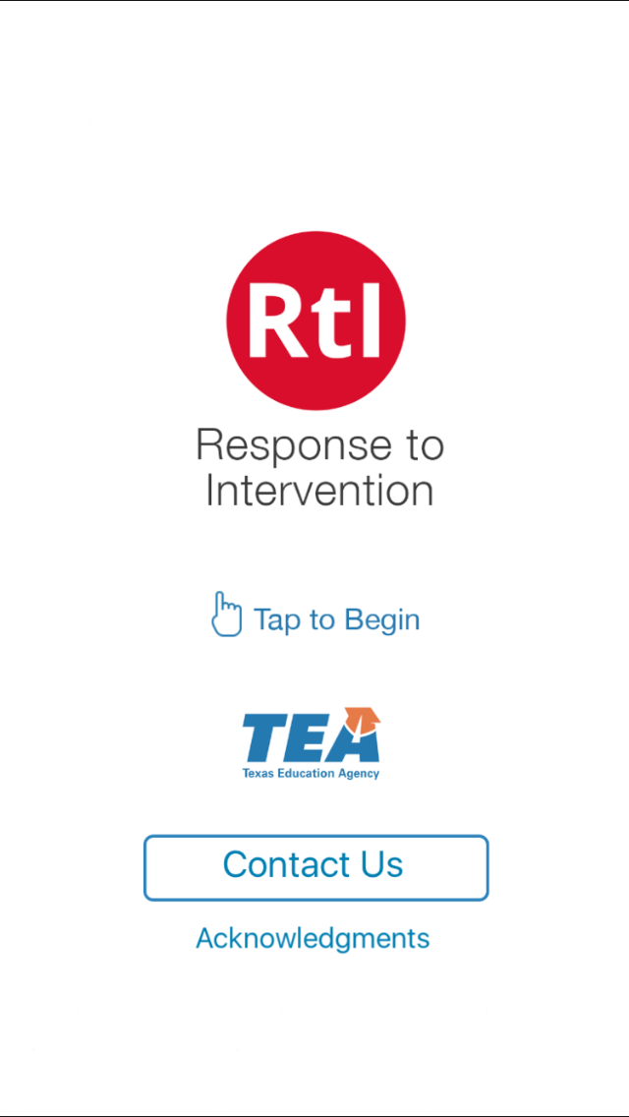
Texas Education Agency RTI Guidance App

Slide 9
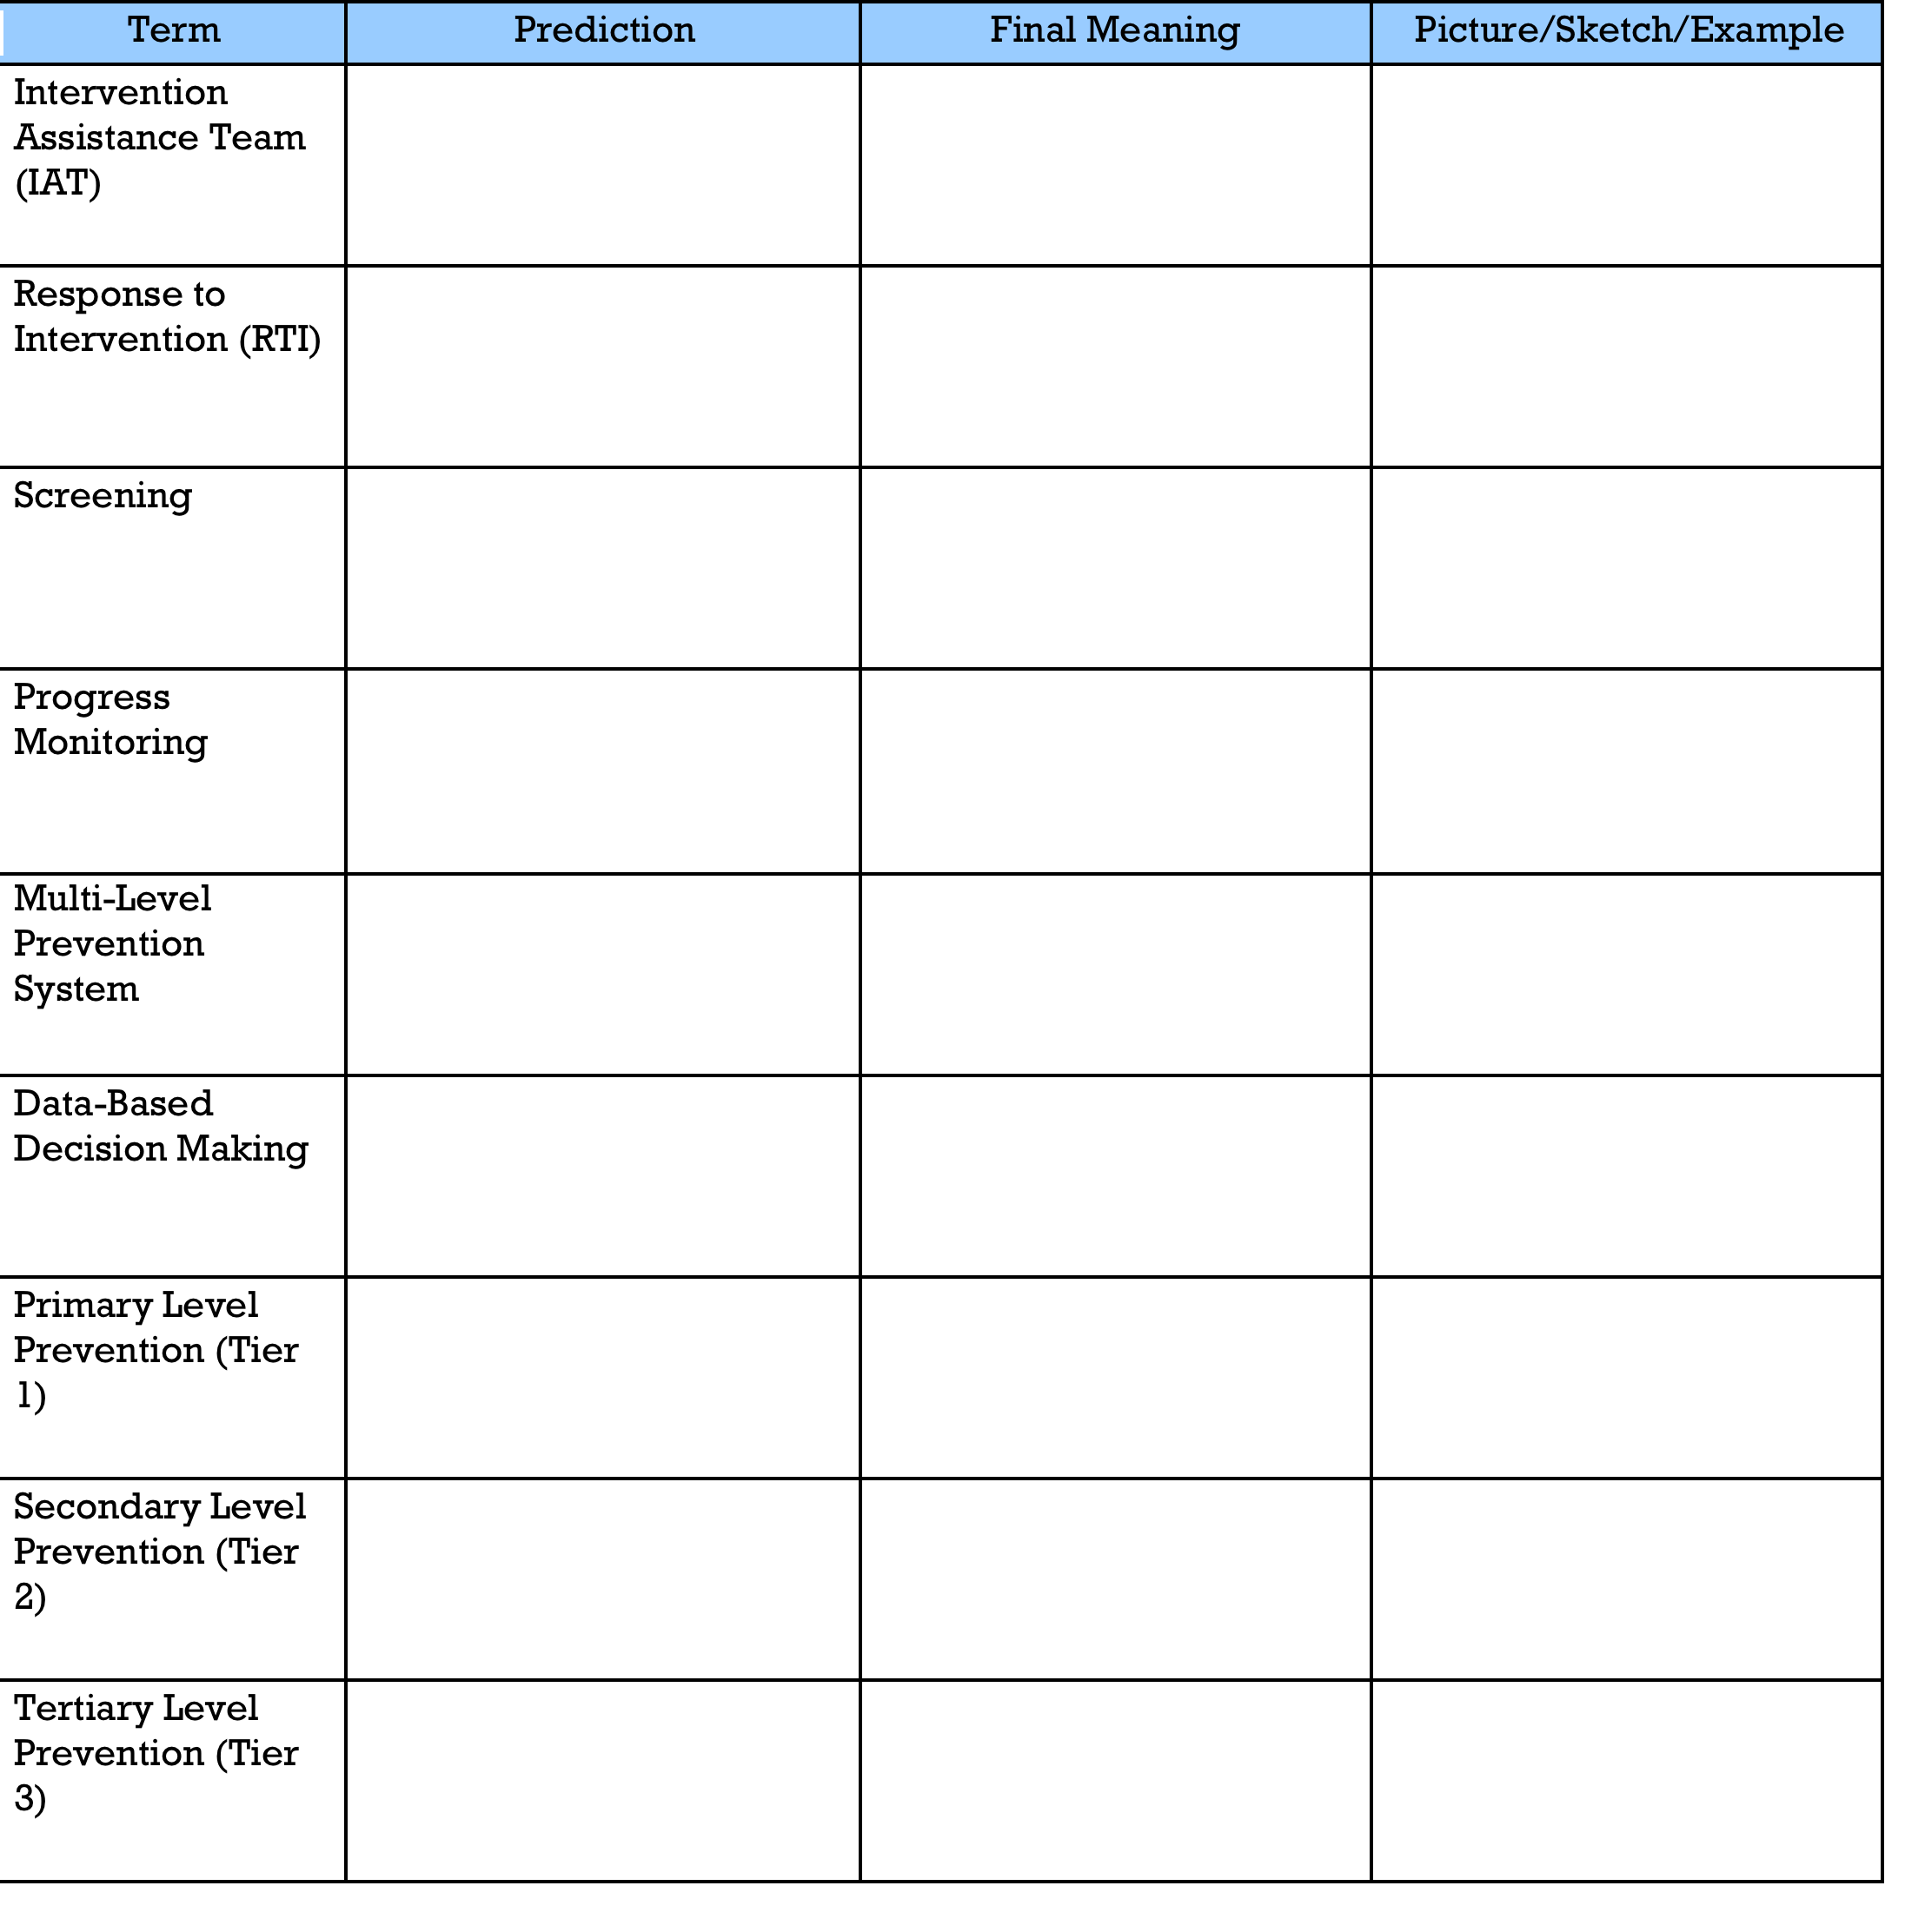
What is IAT and RTI? – Part 2
Directions: Using the HISD website (http://www.houstonisd.org/Page/137095) and the TEA RTI App and the chart below, define each key component of IAT and RTI. This activity is used to show your understanding of key terms related to the basics of IAT and RTI. Under the prediction column fill out what you believe the terms mean prior to the activity. As the terms are found and discussed during the activity add clarification to the final meaning column. Use the picture, sketch, example column to add additional clarifying information after the activity.

Slide 10
Key Ideas
An Intervention Assistance Team (IAT) is a team of professional educators with diverse training and experience who convene to discuss and initiate interventions for students in need of assistance and individualized services.
The IAT team is a problem-solving group whose purpose is to assist teachers, parents, and others with intervention strategies for dealing with the learning needs and behavior problems of students.
Response to Intervention (RTI) is a multi-tier approach to the early identification and support of students with learning and behavior needs.
The RTI process begins with high-quality instruction and universal screening of all children in the general education classroom.

Slide 11
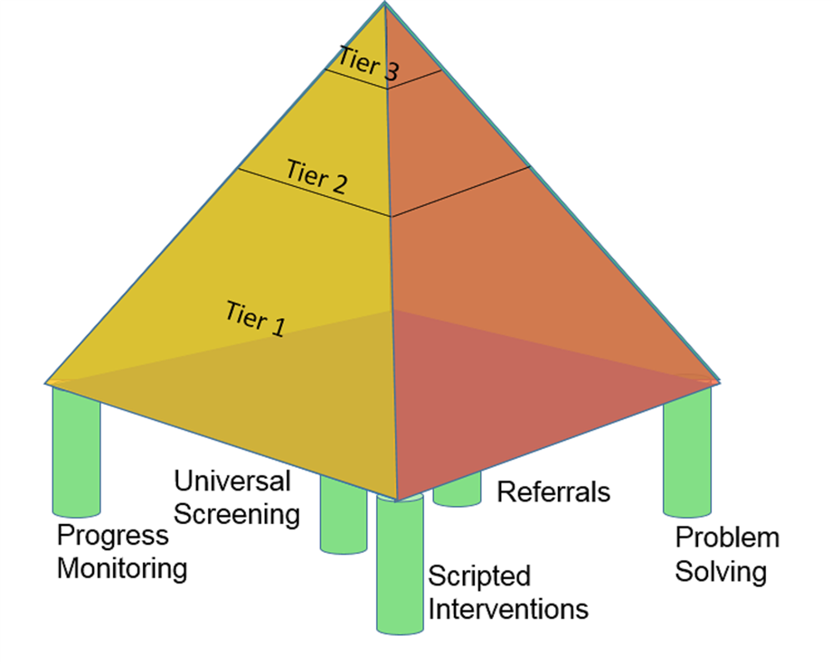
HISD RTI Framework

Slide 12
Assessment of School’s Implementation of RTI
Expert Groups
Directions: Count off to the number 7. Separate by numbers into groups around the room. As a group, read the Center for Response to Intervention Fidelity of Implementation Rubric for your section. Discuss the rubric and become an expert in your section. Be prepared to teach others the components of the rubric for your section. Use chart paper to highlight main points of that section.

Slide 13
Expert Groups
Group Number | Topic
Group 1 | Assessments
Group 2 | Data-based Decision Making
Group 3 | Multi-level Instruction: Tier I
Group 4 | Multi-level Instruction: Tier II
Group 5 | Multi-level Instruction: Tier III
Group 6 | Infrastructure and Support Mechanisms
Group 7 | Fidelity and Evaluation

Slide 14
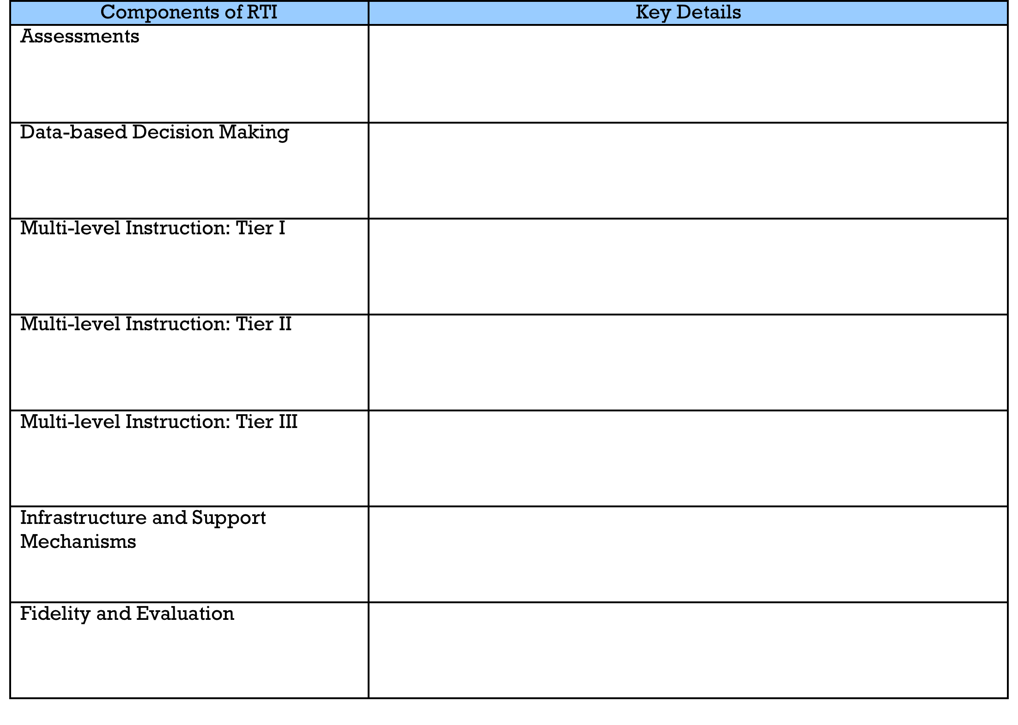
Assessment of School’s Implementation of RTI
Jigsaw Groups
Directions: Reorganize into jigsaw groups with a number from 1-7. Choose one chart paper (rubric section) to begin. The expert from that section teaches the others in the group the information about each section as the group members take notes. Use the graphic organizer below to take notes of key details.

Slide 15
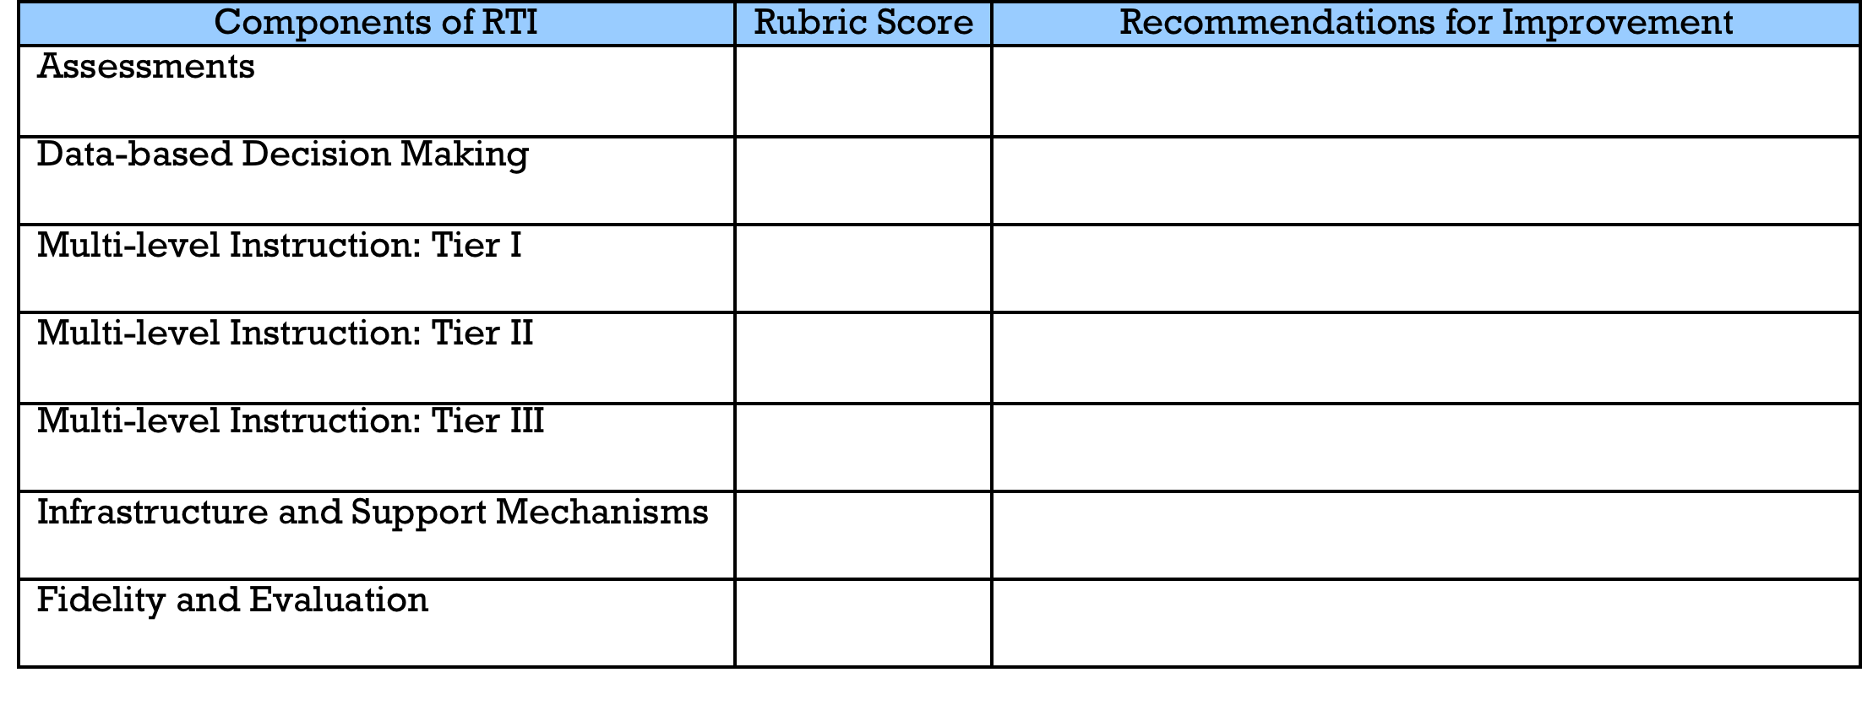
School Assessment
Directions: Based on the rubric, score your school’s implementation of RTI.
Directions: As a group, share and discuss your scores and recommendations. Use chart paper to record the top 5 recommendations from your group. List your group’s top 5 recommendations.

Slide 16
Gallery Walk
Directions: As a group, conduct a gallery walk to review the recommendations from the other groups. Comment on the each group’s recommendations using words or symbols. After conducting the gallery walk, use energy dots to select your top 3 recommendations for implementation throughout the room. List your top 3 recommendations.

Slide 17
Final Personal Reflection
Directions: As an individual, complete the 3-2-1 reflection questions below and be prepared to share with your table group.
List 3 key ideas discussed today that are strengths of the school.
List 2 key ideas discussed today that might be a personal challenge for you as an individual to assist in implementing a robust IAT process.
List 1 question you still have about RTI and your school’s implementation.

Slide 18
Group Reflection
Directions: As a table group, reach consensus on the 3-2-1. Record your group’s responses on chart paper to share with the whole group.
List 3 key ideas discussed today that are strengths of the school.
List 2 key ideas that might be school wide barriers to implementation of a robust IAT process.
List 1 question you still have about RTI and your school’s implementation.

Slide 19
From Your Campus Evaluation Specialist

Slide 20
From Your Campus Evaluation Specialist

Slide 21
From Your Campus Evaluation Specialist

Slide 22
Final Thought
If you’re trying to achieve, there will be roadblocks. I’ve had them; everybody has had them. But obstacles don’t have to stop you. If you run into a wall, don’t turn around and give up. Figure out how to climb it, go through it, or work around it.
- Michael Jordan

Slide 23
THANK YOU
Date: 00/00/2014
Presenter: First and last name
Title

